Slide 1



Rabin karp Algorithm vs My algorithm Analysis

Slide 2

Basic definition
Hash function
Hash table
Preprocessing Algorithms
Fuzzy search

Slide 3
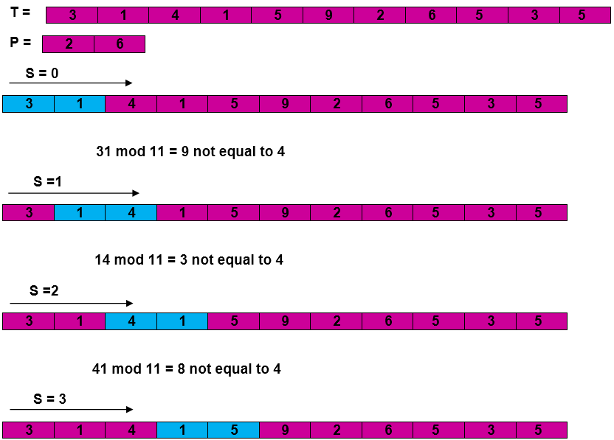
Intro to string searching algorithms
How does Rabin Karp Algorithm works ?
Time complexity W = O(n*m) B= O(n+m)

Slide 4
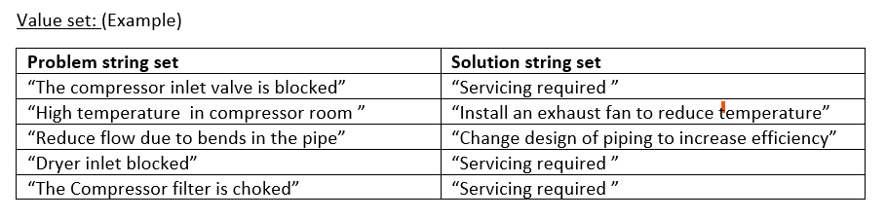
Problem set
First Group
Input format:
[[First group words],[Second group words],[Third group words]]

Slide 5

My Algorithm
Hash function
Nearest prime
Soundex algorithm
Remove common words (0.5) (NLTK lib)
Hash table
Search -> multiple keywords

Slide 6

Comparison
General purpose vs specific
Naïve search vs preprocessing
Time complexity
Space Complexity

Slide 7
What's next
Lager data set
Graphs
Another problem (searching cross word puzzle)

Slide 8
Work Cited
https://nlp.stanford.edu/IR-book/html/htmledition/phonetic-correction-1.html
https://www.geeksforgeeks.org/removing-stop-words-nltk-python/
https://medium.com/@datamonsters/text-preprocessing-in-python-steps-tools-and-examples-bf025f872908
https://stackoverflow.com/questions/32337135/fuzzy-search-algorithm-approximate-string-matching-algorithm
https://medium.com/@aozturk/simple-hash-map-hash-table-implementation-in-c-931965904250
https://www.hackerearth.com/practice/data-structures/hash-tables/basics-of-hash-tables/tutorial/

